Slide 1
Capstone Engagement
Assessment, Analysis, and Hardening of a Vulnerable System
Aaron Boston, Carlos Noriega, Dan Murphy, David Wilson & Randy Johnson

Slide 2
Table of Contents
This document contains the following sections:
01
Network Topology
02
Red Team: Security Assessment
03
Blue Team: Log Analysis and Attack Characterization
Hardening: Proposed Alarms and Mitigation Strategies
04

Slide 3
Network Topology
‹#›

Slide 4
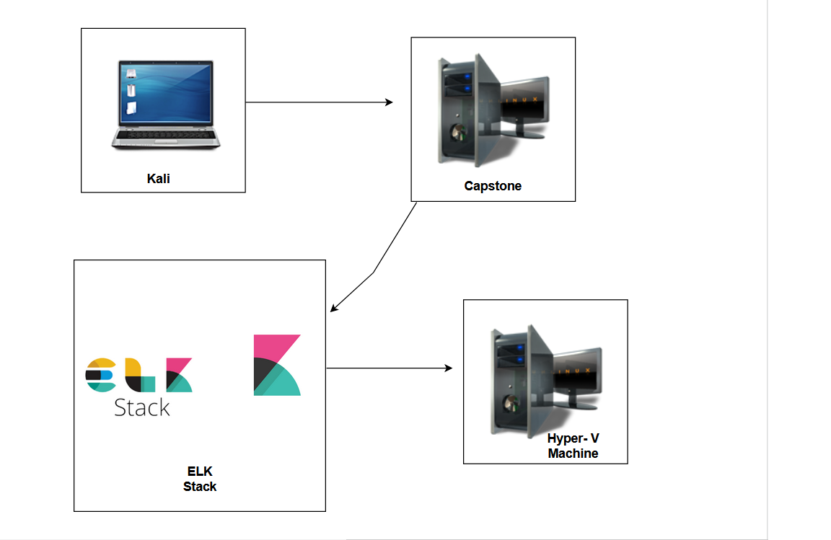
Network Topology
[Insert Here]
Use draw.io to create a diagram of the network.
Add your diagram to this slide and fill out the data in the sidebar.
Network
Address Range:
Netmask:
Gateway:
Machines
IPv4: 192.168.1.90
OS: Linux
Hostname: Kali
IPv4: 192.168.1.105
OS: Linux
Hostname: Capstone
IPv4: 192.168.1.100
OS: Linux
Hostname: ELK Stack
IPv4: 192.168.1.1
OS: Windows
Hostname: Hyper-V
Attack machine to find vulnerabilities
Network logs sent to ELK for monitoring
Logs analyzed with Kibana

Slide 5

Red Team
Security Assessment
‹#›

Slide 6
Recon: Describing the Target
Nmap identified the following hosts on the network:
Hostname | IP Address | Role on Network
Kali | 192.168.1.90 | Attacker Machine
Capstone | 192.168.1.105 | Target Machine
ELK Stack | 192.168.1.100 | Network monitoring & logging data
Hyper-V Azure Machine | 192.168.1.1 | Cloud based host machine

Slide 7
Vulnerability Assessment
The assessment uncovered the following critical vulnerabilities in the target:
Vulnerability | Description | Impact
Weak Passwords | All passwords are simplistic in nature. | Do to the simplicity of each password, they can easily be discovered by tools such as Hydra.
Port 80/TCP CVE-2019-6579 | Port is open and unsecure. | An attacker can easily access administrative privileges by entering the network through an open port.
User names | Every username is the user’s first name. | The first username an attacker may use may be the victim’s first name.
Sensitive Data poorly named. | Folders with important data named, “secret folder”. | Attackers may gravitate towards folders or files with words which implies importance.

Slide 8
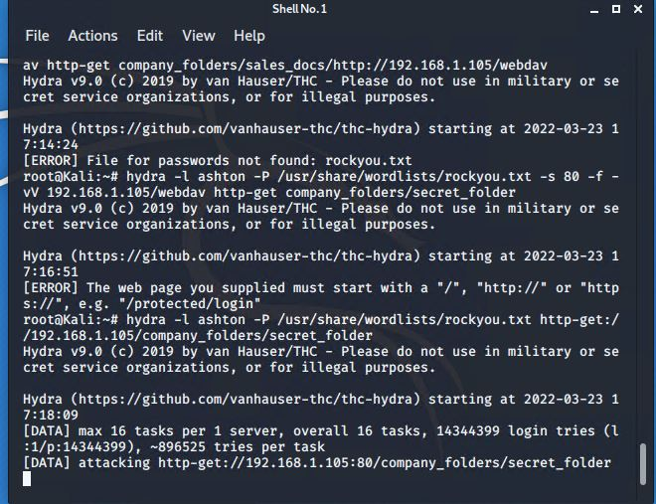

Exploitation: Brute-force attack
01
03
Tools & Processes
Utilizing a Hydra attack we will run:
hydra -l ashton -P /usr/share/wordlist/rockyou.txt -s 80 -f -vV 192.168.1.105 http-get /company_folders/secret_folder.
02
Achievements
This gave us Ashton’s password and access to webdav.

Slide 9
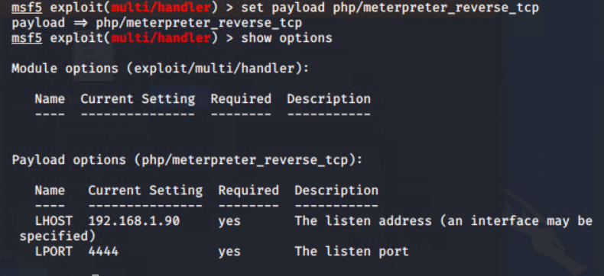
Exploitation: Web Shell PHP Exploit
01
02
03
Tools & Processes
Msfvenom and Metasploit was used to send a payload to the victim’s computer(Capstone computer).
Achievements
This allowed us access to view files on the vulnerable machine.

Slide 10
Exploitation: Password Hash Crack
01
02
With access to Webdev a hash password was found. Using websites like crackstation.net, hashes.com and onlinehashcrack.com.
Achievements
Full access to company’s folder. Password:Linux4u
03

Slide 11

Blue Team
Log Analysis and Attack Characterization
‹#›

Slide 12

Analysis: Identifying the Port Scan
Answer the following questions in bullet points under the screenshot if space allows. Otherwise, add the answers to speaker notes.
What time did the port scan occur?
How many packets were sent, and from which IP?
What indicates that this was a port scan?
[Insert Here]
Include a screenshot of Kibana logs depicting the port scan.

Slide 13
Analysis: Finding the Request for the Hidden Directory
Answer the following questions in bullet points under the screenshot if space allows. Otherwise, add the answers to speaker notes.
What time did the request occur? How many requests were made?
Which files were requested? What did they contain?
[Insert Here]
Include a screenshot of Kibana logs depicting the request for the hidden directory.

Slide 14
Analysis: Uncovering the Brute Force Attack
Answer the following questions in bullet points under the screenshot if space allows. Otherwise, add the answers to speaker notes.
How many requests were made in the attack?
How many requests had been made before the attacker discovered the password?
[Insert Here]
Include a screenshot of Kibana logs depicting the brute force attack.

Slide 15
Analysis: Finding the WebDAV Connection
Answer the following questions in bullet points under the screenshot if space allows. Otherwise, add the answers to speaker notes.
How many requests were made to this directory?
Which files were requested?
[Insert Here]
Add a screenshot of Kibana logs depicting the WebDAV connection.

Slide 16
Blue Team
Proposed Alarms and Mitigation Strategies
‹#›

Slide 17
Mitigation: Blocking the Port Scan
What kind of alarm can be set to detect future port scans?
What threshold would you set to activate this alarm?
What configurations can be set on the host to mitigate port scans?
Describe the solution. If possible, provide required command lines.

Slide 18
Mitigation: Finding the Request for the Hidden Directory
What kind of alarm can be set to detect future unauthorized access?
What threshold would you set to activate this alarm?
What configuration can be set on the host to block unwanted access?
Describe the solution. If possible, provide required command lines.

Slide 19
Mitigation: Preventing Brute Force Attacks
What kind of alarm can be set to detect future brute force attacks?
What threshold would you set to activate this alarm?
What configuration can be set on the host to block brute force attacks?
Describe the solution. If possible, provide the required command line(s).

Slide 20
Mitigation: Detecting the WebDAV Connection
What kind of alarm can be set to detect future access to this directory?
What threshold would you set to activate this alarm?
What configuration can be set on the host to control access?
Describe the solution. If possible, provide the required command line(s).

Slide 21
Mitigation: Identifying Reverse Shell Uploads
What kind of alarm can be set to detect future file uploads?
What threshold would you set to activate this alarm?
What configuration can be set on the host to block file uploads?
Describe the solution. If possible, provide the required command line.

